Slide 1
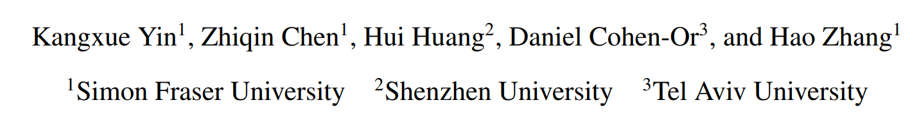
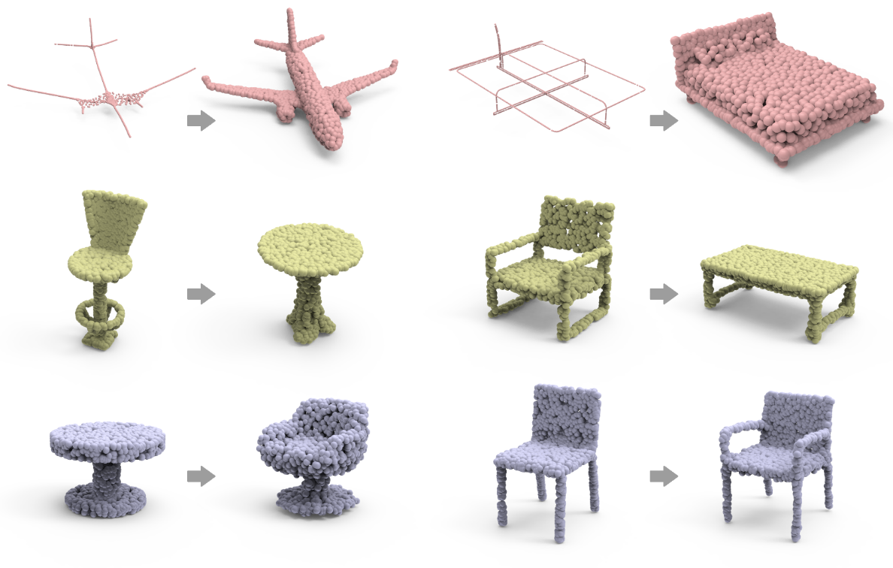
LOGAN: Unpaired Shape Transform in Latent Overcomplete Space
Our deep neural network, LOGAN, learns shape transforms from unpaired domains.
The same network can transform from skeletons to shapes, from cross-sectional profiles to surfaces, between chairs and tables; it can also add/remove parts, such as the armrests of a chair.

Slide 2
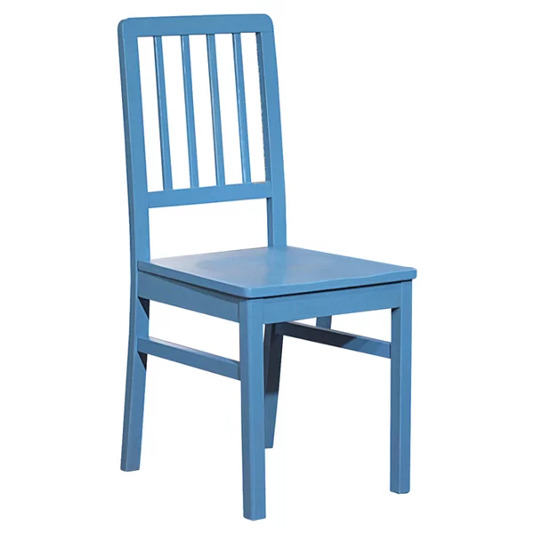
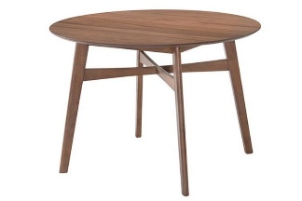
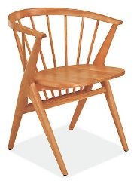
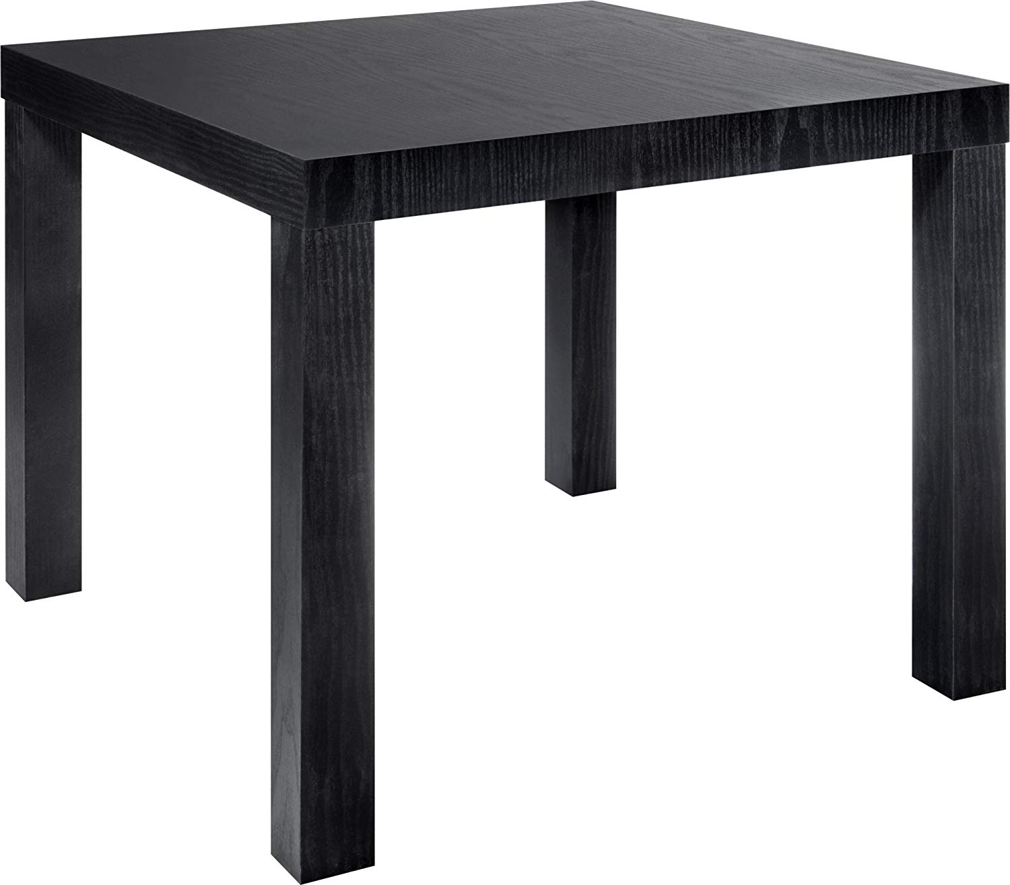
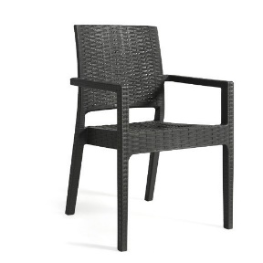
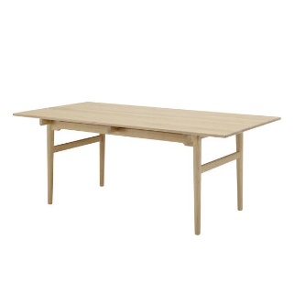
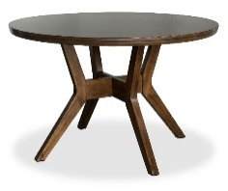
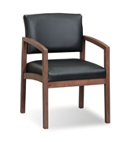
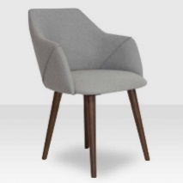
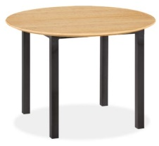
To learn shape transforms from unpaired domains, the key challenge:
It is unknown what features are to be preserved/altered

Slide 3
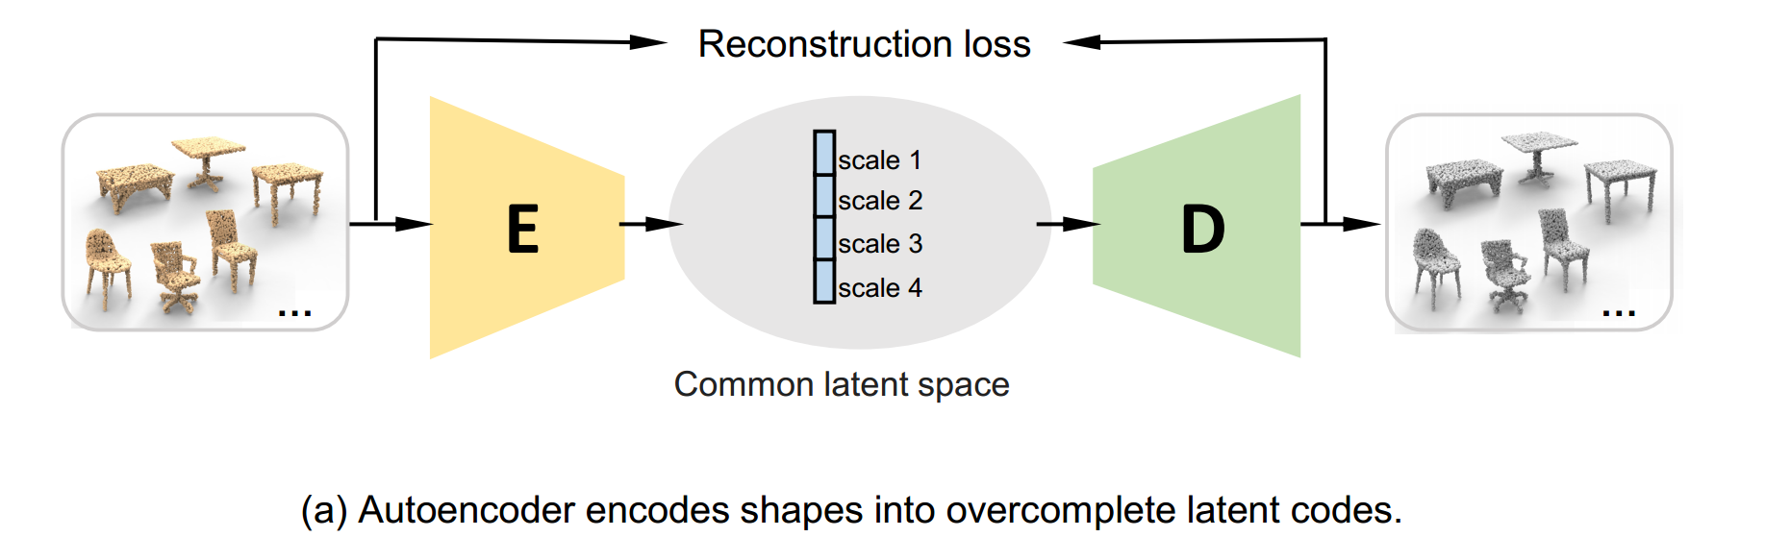
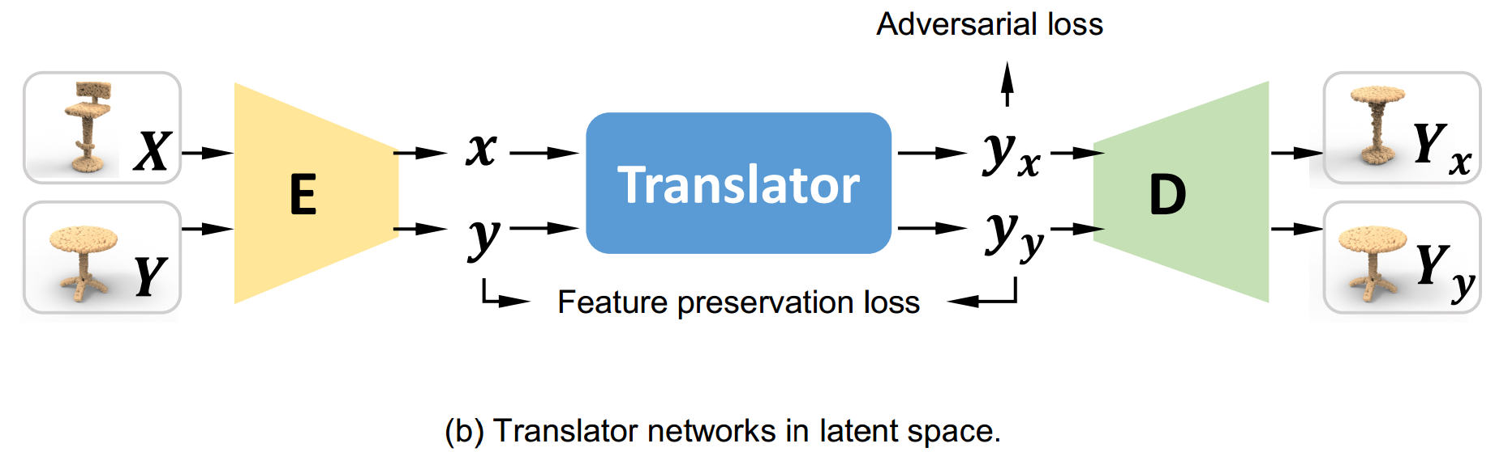
Overview of our network architecture
Our network is designed with two novel features to overcome the challenge:
• Our autoencoder is jointly trained by the two domains. It encodes shape features into an overcomplete latent code. Our motivation is that an overcomplete code for the shape transform would leave more degree-of-freedom to the translator network to facilitate an implicit disentangling of the preserved and altered shape features.
• In addition, our chair-to-table translator is not only trained to turn a chair code to a table code, but also trained to turn a table code to the same table code, as shown in Figure (b). Our motivation for the second translator loss, which we refer to as the feature preservation loss, is that it would help the translator preserve table features (in an input chair code) during chair-to-table translation.

Slide 4
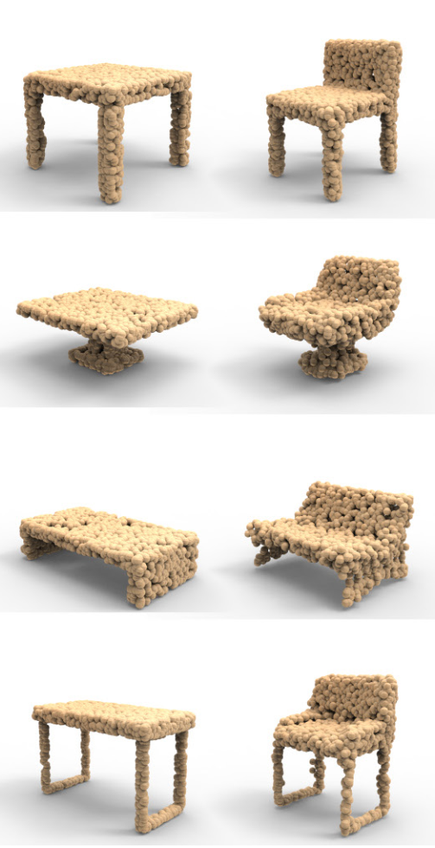
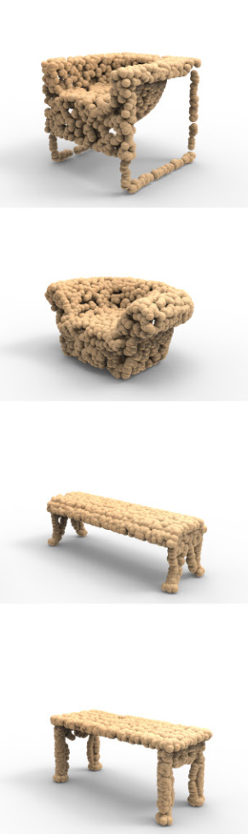
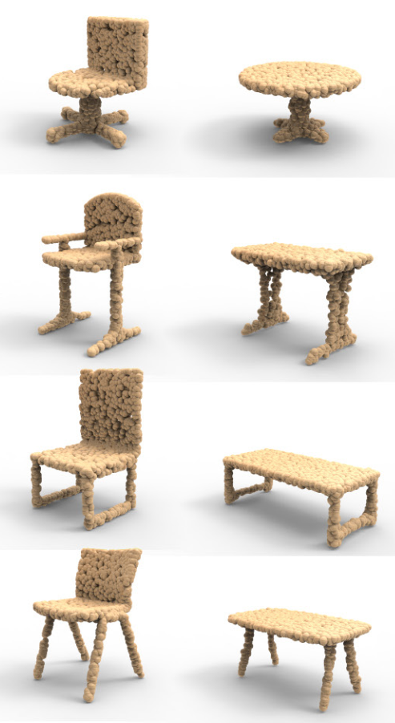
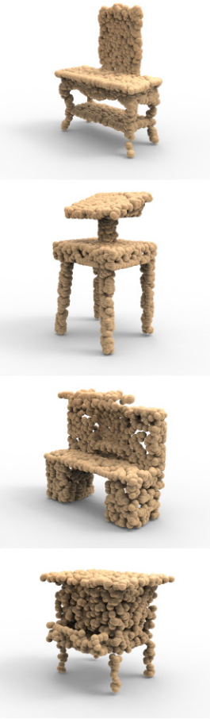
Result: Table ↔ Chair
input table output chair retrieved shape
input chair output table retrieved shape

Slide 5
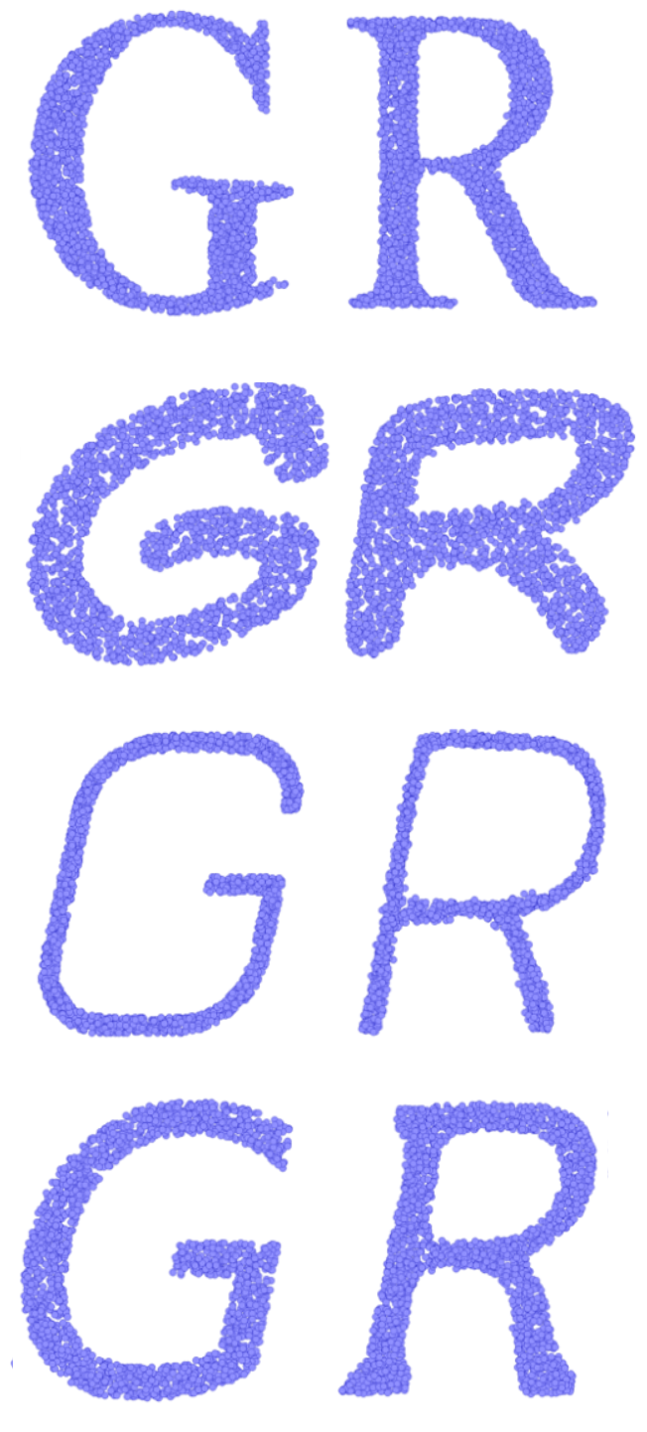
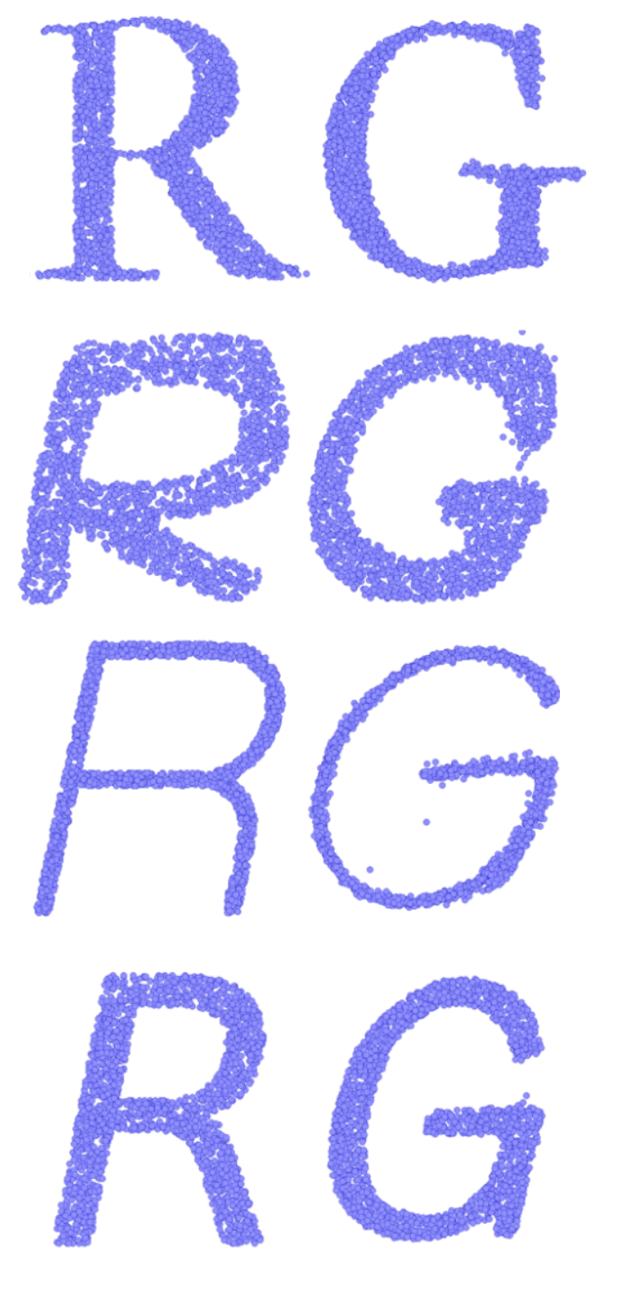
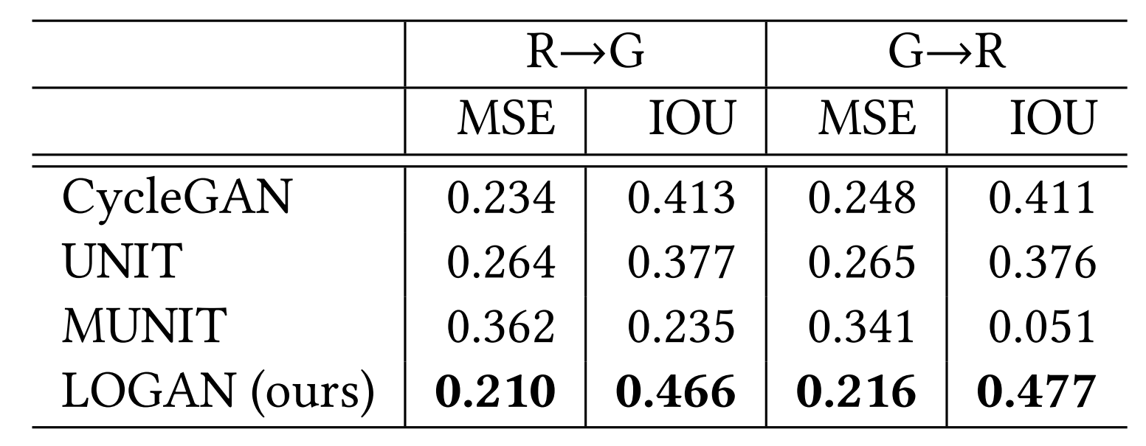
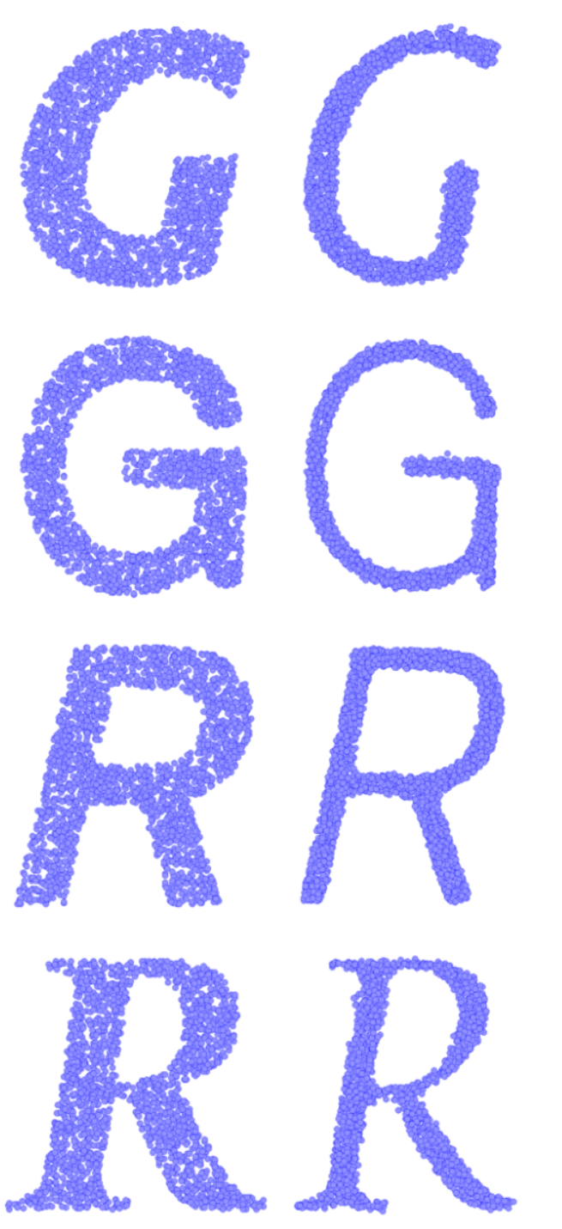
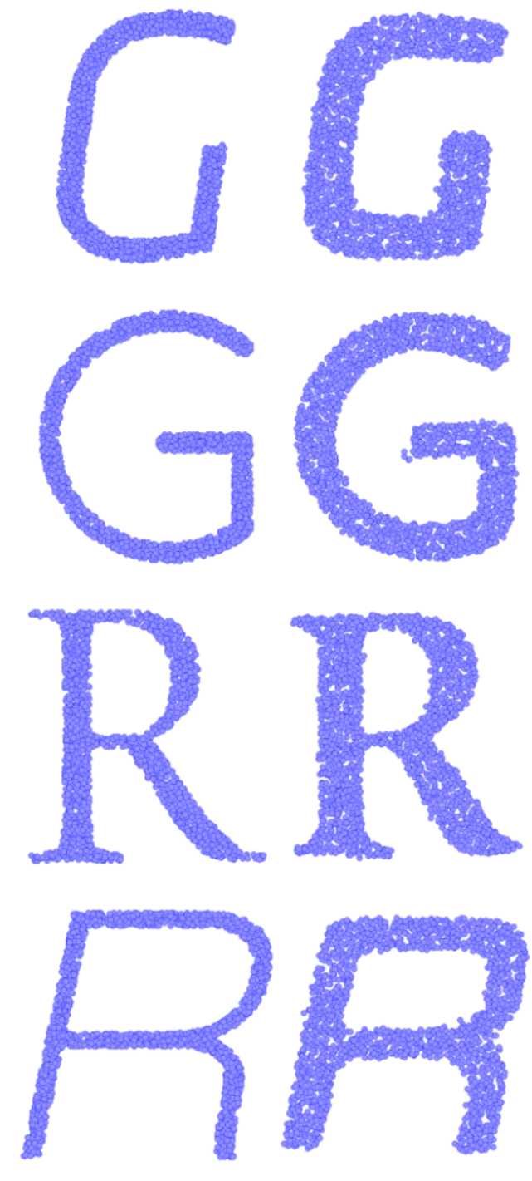
Either content transfer or style transfer, depending on the training domains.
G → R
R → G
Depending on the input (unpaired) domains, our network LOGAN can learn both:
Content Transfer (G ↔ R ), and
Style Transfer (thick ↔ thin ),
without any change to the network architecture.
thick → thin
thin → thick

Slide 6
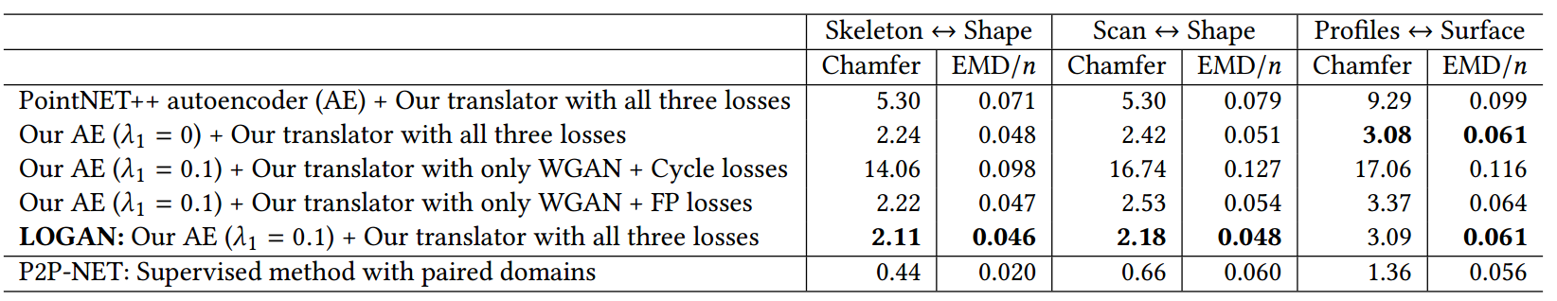
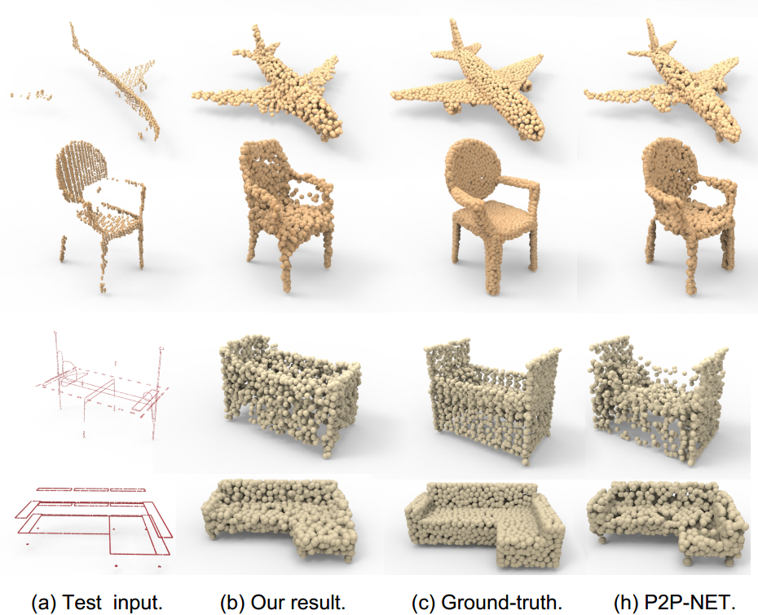
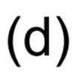
Ablation study on datasets of P2P-NET
We compare our results to P2P-NET, as well as results of different network configurations.
Note that these shape transforms, e.g., cross-sectional profiles to shape surfaces, are of a completely different nature compared to table-chair translations.
Our network is able to produce satisfactory results, as shown in column (b), which are visually comparable to results obtained by P2P-NET, a supervised method

Slide 7
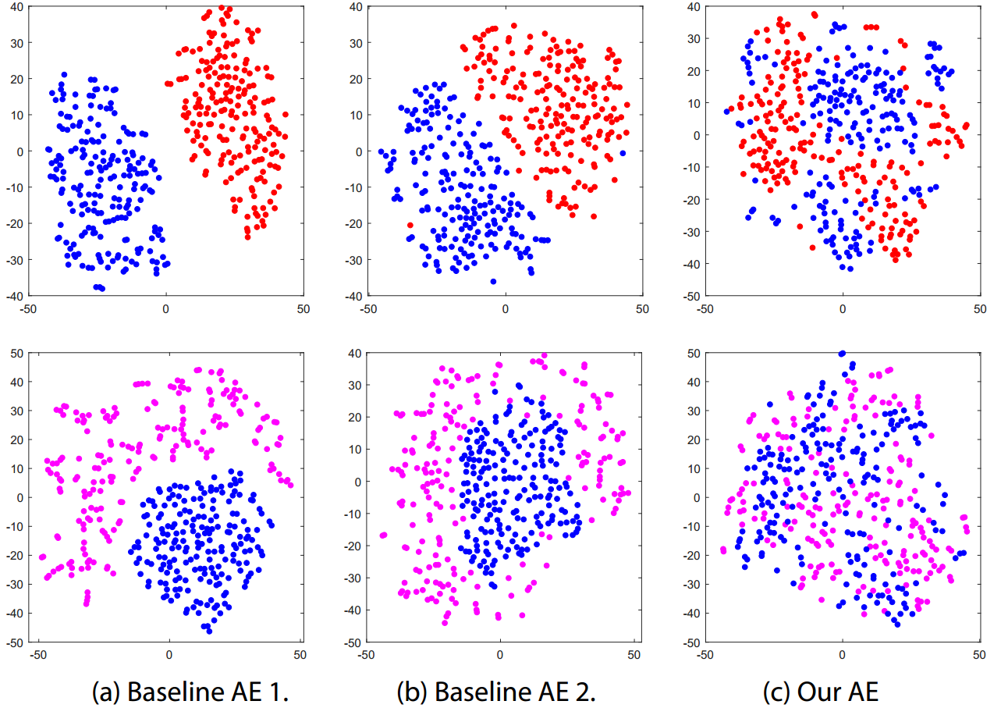
Visualization 1. Joint embeddings of table and chair latent codes
red = original chair code ;
blue = original table code
magenta = chair code after translation; blue = original table code
We visualize the common latent spaces constructed by our autoencoder and two baselines by jointly embedding the chair and table latent codes. We can observe that, compared to the two baselines, our default autoencoder brings the chairs and tables closer together in the latent space since it is able to better discover their common features.

Slide 8
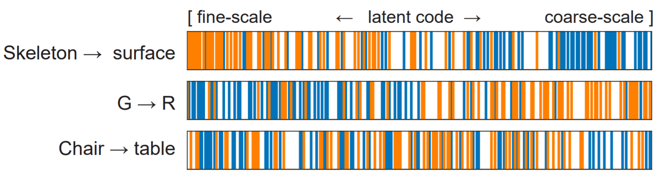
Visualization 2. Joint embeddings of table and chair latent codes
Visualizing “disentanglement” in latent code preservation (blue color) and alteration (orange color) during translation, where each bar represents one dimension of the latent code.
Orange bars: top 64 latent code dimensions with the largest average changes.
Blue bars: dimensions with smallest code changes.
We can observe that our network automatically learns the right features to preserve (e.g., more global or coarser-scale features for skeleton→surface and more local features for G→R ), solely based on the input domain pairs. For the chair→table translation, coarse- and fine-level level features are both impacted.

